Slide 1

AI Research Abstract Generators: Revolutionizing Academic Summaries
This presentation explores how AI-powered abstract generators are transforming the academic research landscape, offering innovative solutions to a long-standing challenge for scholars and scientists.

Slide 2
The Challenge of Writing Abstracts
Conciseness is Key
Time-Consuming Process
Nuance & Detail
Abstracts must succinctly summarize complex research in a limited word count (typically 150-250 words), demanding extreme precision.
Researchers often struggle to capture the core findings and key methodologies without oversimplifying or losing crucial nuances.
Crafting an effective abstract is a laborious task, requiring significant time to balance clarity, completeness, and academic rigor.
Writing abstracts presents a unique bottleneck in the research publication process, often causing frustration and delays for even experienced scholars.

Slide 3

What is an AI Abstract Generator?
AI abstract generators are sophisticated tools designed to automatically create summaries from full research papers or other long-form text inputs.
These tools leverage Natural Language Processing (NLP) and machine learning algorithms, trained on vast datasets of published academic abstracts. This extensive training enables them to understand the structure and common elements of research summaries.
Their primary aim is to save researchers time and alleviate "writer’s block" by providing high-quality draft summaries.

Slide 4



How AI Abstract Generators Work
Input
AI Analysis
Output
Users upload or paste the main body of their paper (Introduction to Conclusion, excluding existing abstract and references).
The AI analyzes the text's structure, identifying key elements such as the research purpose, methodologies used, primary results, and overall conclusions.
A concise, coherent abstract is generated, formatted to follow academic norms and style guidelines.
The process is designed to be user-friendly, translating complex AI operations into a straightforward workflow for researchers.

Slide 5
Leading AI Abstract Generators Today
1
2
Writefull Abstract Generator
Originality.ai Abstract Generator
Free, trained on published papers, integrates with Word & Overleaf, and respects privacy by not storing texts.
Offers finetune options, emphasizes clarity and flow, making it ideal for students and researchers.
3
4
Grammarly AI Abstract Generator
Writingmate AI Abstract Generator
Known for producing professional, polished abstracts, including support for mixed-methods research examples.
Supports multiple file formats, generates APA style abstracts, and is noted for its free and fast generation capabilities.
These tools offer varied features, catering to different academic and professional needs while striving for accuracy and efficiency.

Slide 6




Key Benefits of Using AI Abstract Generators
Time Savings
Enhanced Clarity
Drastically reduces hours spent on manual summarizing and repetitive rewriting of research papers.
Generates clear, well-structured abstracts that effectively highlight the main points and contributions of the research.
Broad Accessibility
Iterative Refinement
Makes professional-quality abstract writing accessible to students, researchers, and business professionals alike.
Supports an iterative approach, allowing multiple generation attempts to achieve the desired summary quality.

Slide 7

Real-World Example: Writefull Abstract Generator
Simple Workflow: Users simply paste their paper text and click "Generate Abstract" for an instant draft.
Academic Accuracy: The underlying model is trained on millions of title-abstract pairs, ensuring the generated text adheres to academic conventions.
Robust Privacy: User texts are encrypted and immediately deleted after processing, safeguarding sensitive research data.
Integration & Access: Offers a free daily quota and plugin integration for seamless workflow within academic writing environments like Word and Overleaf.

Slide 8
Best Practices When Using AI Abstract Generators
1
2
Review & Revise
Starting Point, Not Final
Always thoroughly review and revise AI-generated abstracts for accuracy, tone, and consistency with your original research.
Treat AI output as a strong draft or starting point, rather than a final submission. Human oversight is crucial.
3
4
Leverage Expertise
Check Guidelines
Combine the AI's efficiency with your unique domain expertise to ensure the abstract effectively highlights your research's unique contributions.
Consult institutional or publisher guidelines regarding the use of AI tools in academic writing to ensure compliance.

Slide 9
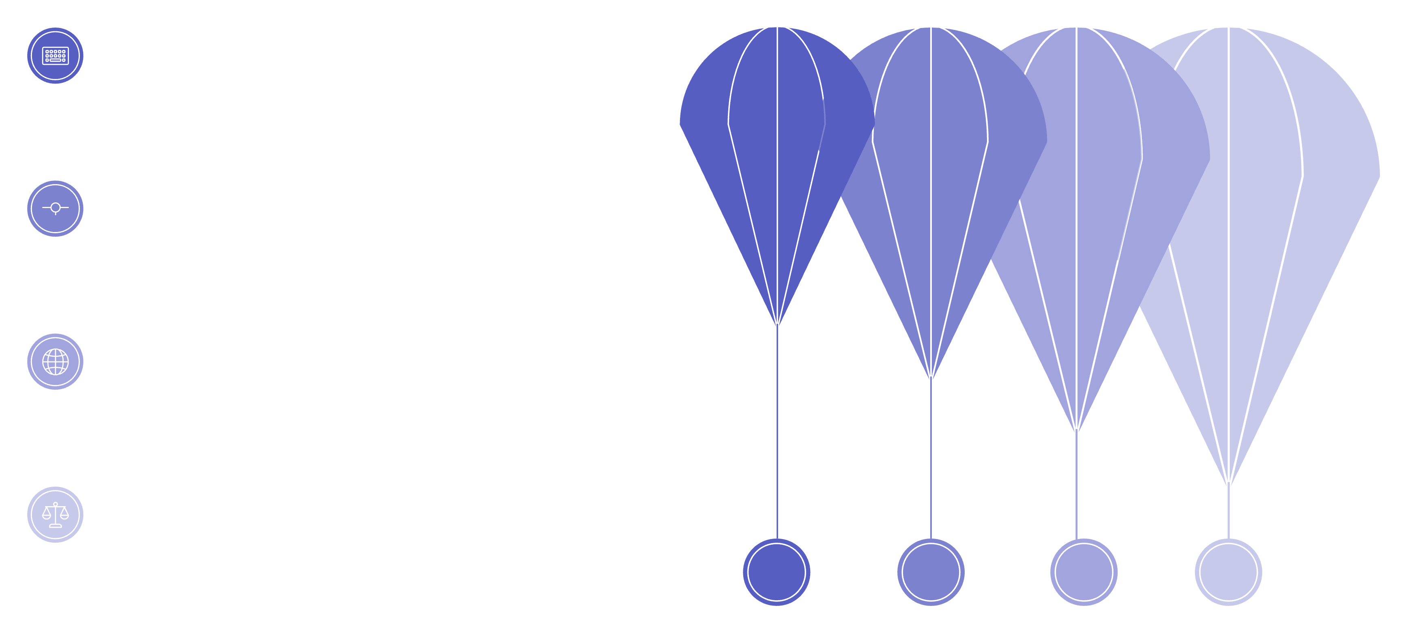




The Future of AI in Academic Writing
Current Integration
AI assists drafting and editing
Advanced Customization
Tailored voice and structure
Multilingual Capability
Seamless cross-language support
Ethical Stewardship
Transparency and responsible use
As AI technology advances, its role in academic writing will deepen, providing increasingly sophisticated support while emphasizing responsible use.

Slide 10

Conclusion: Empower Your Research with AI Abstract Generators
Transformative Impact: AI tools are transforming abstract writing from a bottleneck into a streamlined, efficient step in the research process.
Democratizing Access: They democratize access to professional-quality summaries, benefiting researchers at all stages of their careers.
Focus on Discovery: By automating drafting, AI empowers you to focus more on critical thinking, experimentation, and scientific discovery.
Start Experimenting Today: Begin leveraging these powerful tools with free options like Writefull, Grammarly, and Originality.ai to enhance your research workflow.

